Slide 1
AP Human Geography Unit I
Geography: It’s Nature & Perspectives

Slide 2
What is Geography?
The word geography was invented by the Greek scholar Eratosthenes.
Geo means “Earth”
graphy means “to write”
Geography literally means “to write about the Earth”

Slide 3
What is Geography?
Charles Gritzner defines geography as:
“the study of what, is where, why there, and why care”
“pertaining to the various physical and human features of Earth’s surface, including their conditions, interactions, spatial distributions, and patterns.”
In short, geography is a description of the Earth’s surface and the people and processes that shape its landscapes.
Notes:
Insert a picture of one of the points of interest for your country.

Slide 4
Pattison – Things to Consider
Does Pattison’s division of geography into 4 traditions have merit? In other words, why did Pattison seek to identify traditions within geography in the first place?
Does he possibly neglect other aspects of geography? If so, what is he leaving out?
Based on Pattison’s conclusions, is geography “one” or “many”?
What do you see as being the most compelling tradition of Pattison’s 4? Least compelling?

Slide 5
Geographic Perspectives
Perspective means “the ability to see all relevant data in a meaningful relationship”
Tobler’s 1st Law of Geography
“Everything is related to everything else, but near things are more related than distant things.”

Slide 6
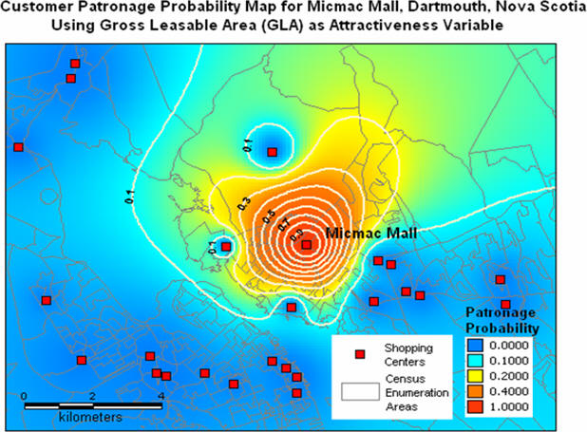

Slide 7
5 Themes of Geography
The American Association of Geographers (AAG) and the National Council for Geographic Education (NCGE) constructed 5 themes of geography in 1981
Place
Location
Region
Human-Environment Interaction
Spatial Interaction or Movement

Slide 8
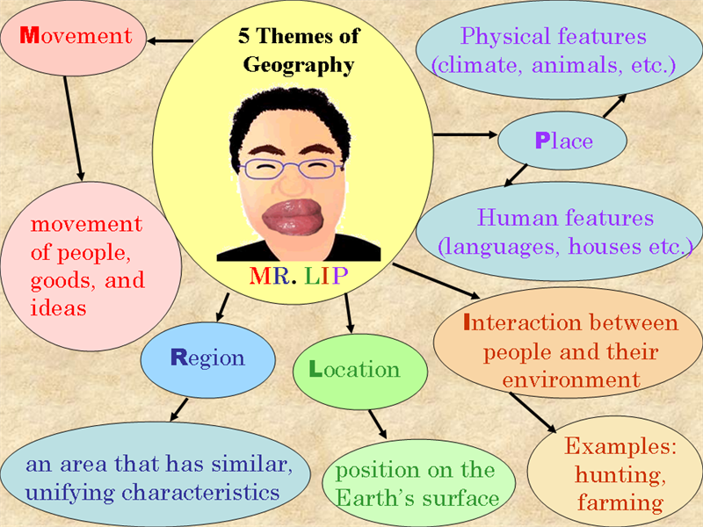
Source: Google images

Slide 9
5 Themes of Geography – Place & Location
Place – the description of what and how we see and experience a certain aspect of Earth’s surface.
It is a description of what the place is like or what makes it unique
Each place on Earth is unique and at the same time similar to other places
Place is often identified by it’s location
The position that something occupies on Earth’s surface
Absolute Location – the exact spot where something is located
Relative Location – location in reference to another feature

Slide 10
5 Themes of Geography – Place & Location
Location is identified by four ways
Place Name
Site
Situation
Mathematical Location
Place names, also called toponyms, are the most common forms of identifying location.
All places on Earth, inhabited or uninhabited, have a name.
Disappointment Islands; Scratchy Bottom; Shades of Death Road; Truth or Consequences, New Mexico; Boogertown, North Carolina

Slide 11
5 Themes of Geography – Place & Location
Toponyms are created for different reasons:
A person
Religion
Other places
Trait of the area
Economy
Ethnicity
Physical Features
The Board of Geographical Names, operated by the US Geological Survey, was established to be the final say of names on US maps.

Slide 12
5 Themes of Geography – Place & Location
Site – the internal physical character of a place
Characteristics include:
Climate
Water resources
Topography
Soil
Vegetation
Latitude
Elevation
People consider these characteristics when selecting locations
Absolute Location

Slide 13
5 Themes of Geography – Place & Location
Situation – the location of a place relative to other places
Relative Location
Situation helps find an unfamiliar place by comparing its location with a familiar one
Situation helps us understand the importance of a location
Accessibility

Slide 14
5 Themes of Geography – Place & Location
Mathematical Location – describing places on Earth in precise terms
Grid Pattern – two sets of imaginary lines drawn over the Earth’s surface.
Meridian – an arc drawn between the north and south poles
Parallel – a circle drawn around the globe parallel to the equator. These are at right angles to the meridians

Slide 15
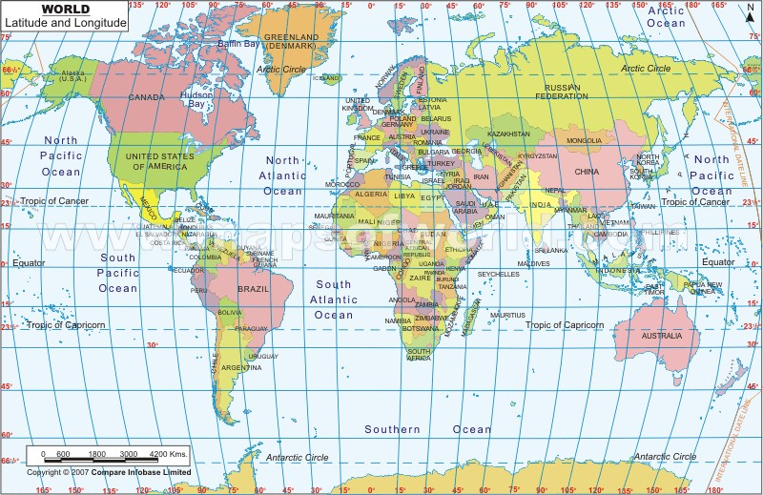

Slide 16
5 Themes of Geography – Place & Location
Meridians are identified on the Earth’s surface by a numbering system called longitude.
Longitude begins at 0° called the Prime Meridian
Royal Observatory in Greenwich, England
Prime Meridian splits the Earth into the Western and Eastern Hemisphere.
Longitude lines are numbered between 0 and 180 to the east and west of the Prime Meridian
On the opposite side of 0° is 180°. This is called the International Date Line

Slide 17
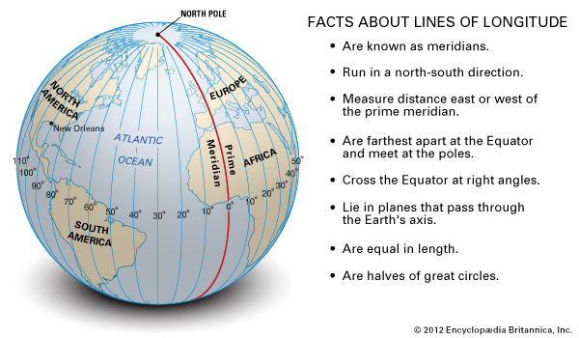

Slide 18
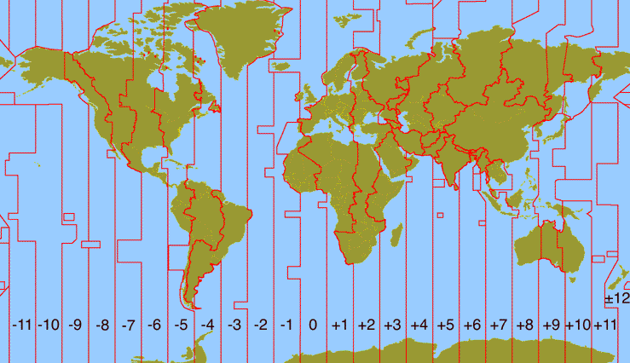
5 Themes of Geography – Place & Location
Meridians are important for calculating time.
15° of longitude equals one hour of time.
Time zone lines can vary depending on political situations and locations of countries in the Pacific Ocean.

Slide 19
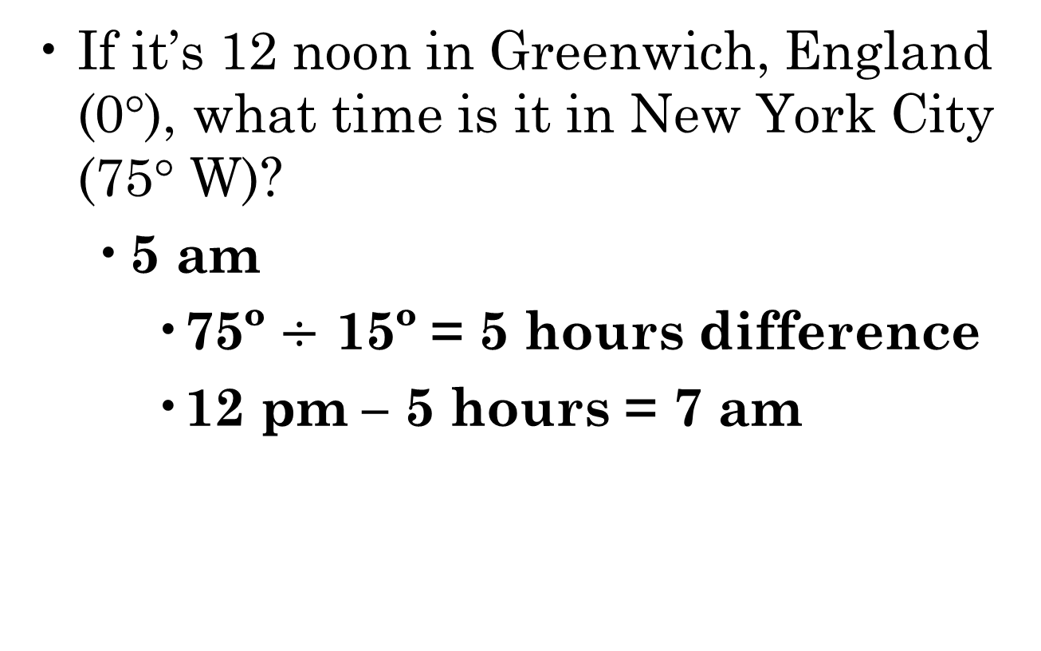
5 Themes of Geography – Calculating Time

Slide 20
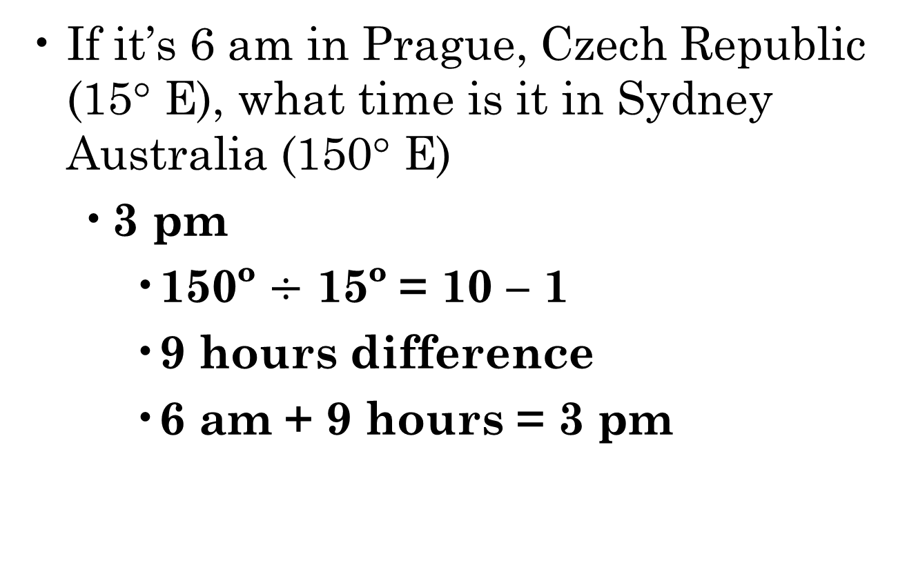
5 Themes of Geography – Calculating Time

Slide 21
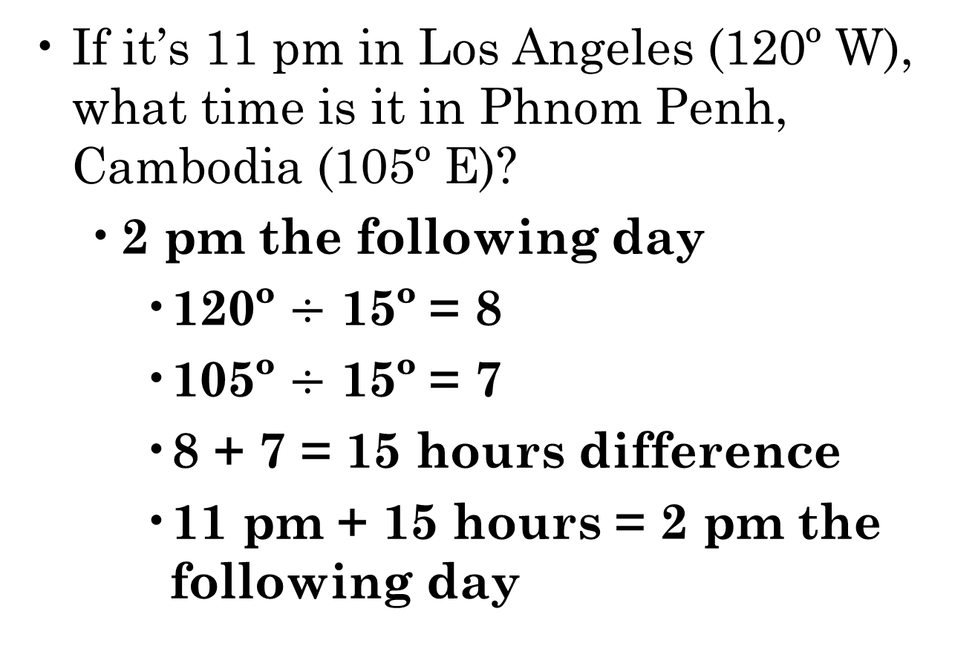
5 Themes of Geography – Calculating Time

Slide 22
5 Themes of Geography – Place & Location
Parallels are identified on the Earth’s surface by a numbering system called latitude.
Latitude begins at 0° called the Equator.
The Equator runs across the fattest part of the Earth.
It separates the Earth into the Northern and Southern hemispheres.
Latitude lines are numbered between 0º and 90° to the north and south of the Equator.
Tropic of Capricorn and Cancer
Arctic and Antarctic Circles
North and South Poles
Latitude and Longitude lines make up the basis for Global Positioning Systems (GPS)
Essential for all absolute location coordinates

Slide 23
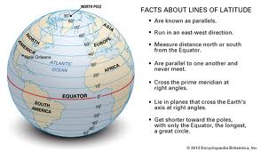

Slide 24
5 Themes of Geography – Place & Location
Other Mathematical Locations
US Land Ordinance of 1785
Divided the territory of the US into a system of townships and ranges
Designed to help the settlement of the west
Thomas Hutchins
Township is an area of 6 square miles
North-South lines are called principal meridians
East-West lines are called base lines
Townships were divided into 36 sections

Slide 25
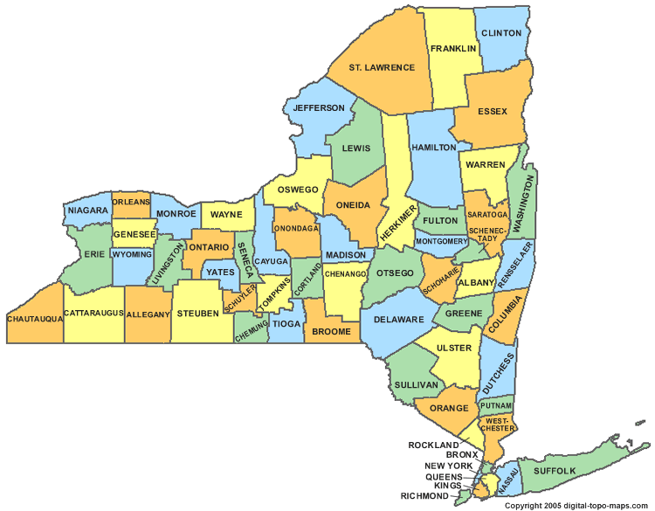
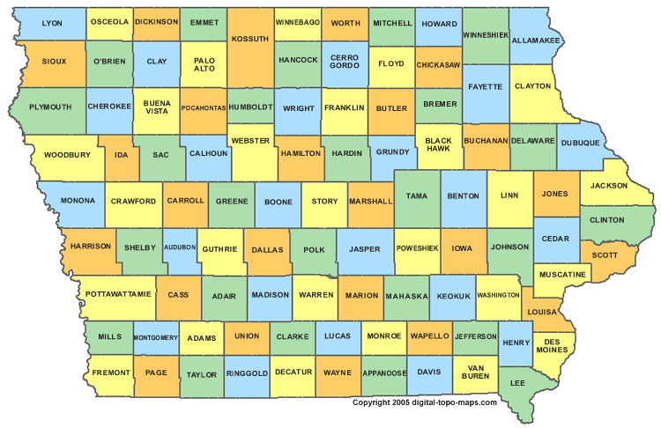
5 Themes of Geography – Place & Location
New York county map
Iowa county map

Slide 26
Discussion Starter
Grab a blank US political map and red pen from the front desk as you come in.
Outline the states that make up “the South.”
What method or criteria did you use to include and/or exclude states from your definition of the South?
Are there sub-regions within the South itself, or is it a single, unified region?
What is the shortest distance between New York City and Los Angeles? Draw this route on your map.

Slide 27
5 Themes of Geography - Regions
What is “sense of place?”
What gives a place distinct character that sets it apart from any other place?
Uniqueness

Slide 28
5 Themes of Geography - Regions
Carl Sauer – “Cultural Landscape”
“The Morphology of Landscape”
“The cultural landscape is fashioned from natural landscape by a cultural group. Culture is the agent, the natural are the medium, the cultural landscape is the result.”
Culture is a force in changing the natural landscape

Slide 29
5 Themes of Geography - Regions
Regional Studies – geographic study of the cultural landscape
Paul Vidal de la Blanche
Jean Bruhnes
Robert Platt
Yi-Fu Tuan
topophilia - “love of place”

Slide 30
5 Themes of Geography - Regions
Regional Studies
Each region has its own distinctive landscape that results from a unique combination of social relationships and physical processes
Within a region the people, activities, and environment will display similarities and regularities and differ in some way from other regions
What are the relationships between characteristics that create a connectedness?

Slide 31
5 Themes of Geography - Regions
Regions are any area larger than a point and smaller than an entire planet.
3 Types of regions
Formal
Functional
Vernacular

Slide 32
5 Themes of Geography - Regions
Formal Region – area where everyone shares in common one or more distinctive characteristics
Also known as a uniform or homogenous region
Countries, states, counties, cities, and towns
Products produced
Most characteristics are predominant and rarely universal
CAUTION!!! – Be sure to recognize the diversity of cultural, economic, and environmental factors while making a generalization.

Slide 33
5 Themes of Geography - Regions
Functional Regions
Also known as nodal regions
Areas organized around a node or focal point
Characteristics are stronger closer to the node and diminish with distance
Examples include circulation area of a newspaper, television viewing areas, and shopping malls

Slide 34
5 Themes of Geography - Regions
Vernacular Regions
Also known as perceptual regions
A place that people believe exists as part of their cultural identity
Examples include “the American South,” “Dixie,” and “Big Orange Country.”
John Shelton Reed
Dixie and the South

Slide 35
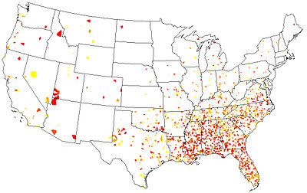
5 Themes of Geography - Regions
Number of businesses with “Dixie” in the name

Slide 36
Timed Writing Assignment
Regionalization is the foundation to understanding Geography. It gives a person the ability to group like items and to study what connects them:
Define formal, functional, and vernacular regions giving an example of each.
John Shelton Reed uses the simile of comparing the South to his favorite pair of blue jeans. “It’s shrunk some, faded a bit, got a few holes in it.” Making at least three specific references to the modern day south, what is Reed trying to say with this comparison?
Joel Garreau makes an argument that Kansas City should be the capital of the Bread Basket Nation. Using his reasoning, what city should be the capital of Dixie and why?

Slide 37
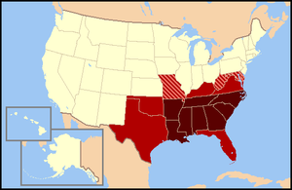
5 Themes of Geography - Regions
The “American South”

Slide 38
5 Themes of Geography – Human Environment Interaction
The Netherlands (also called Holland)
“God made Earth, but the Dutch made the Netherlands”
Among the most densely populated countries on Earth
½ of land is below sea level
Polders – land that is created by draining water from an area
Dikes – walls built to hold back bodies of water

Slide 39
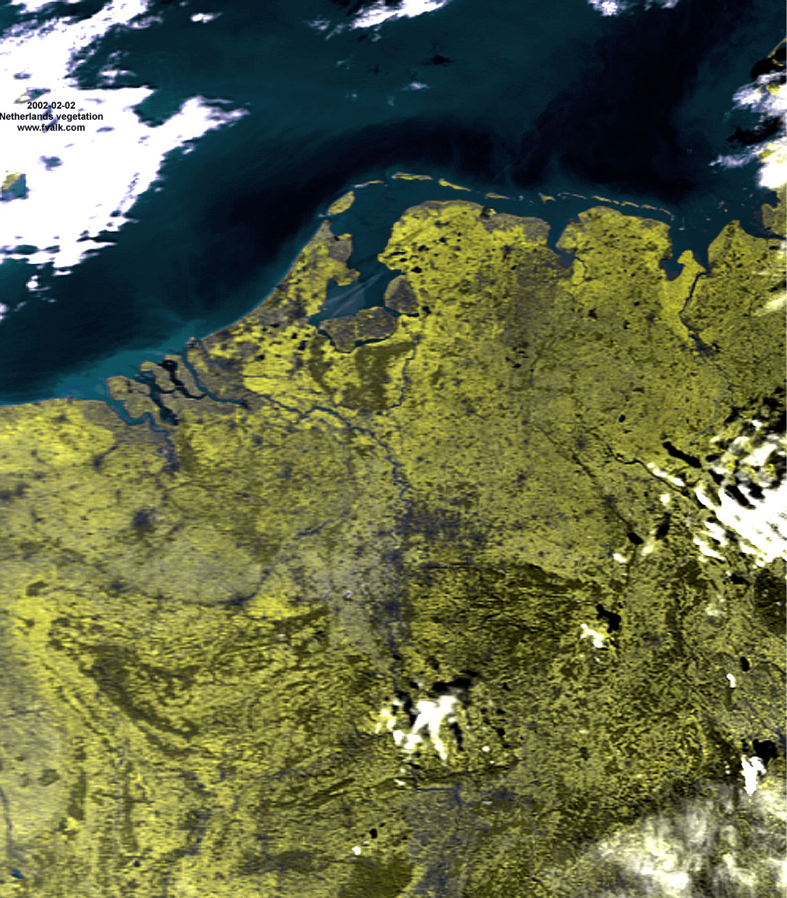
5 Themes of Geography – Human Environment Interaction

Slide 40
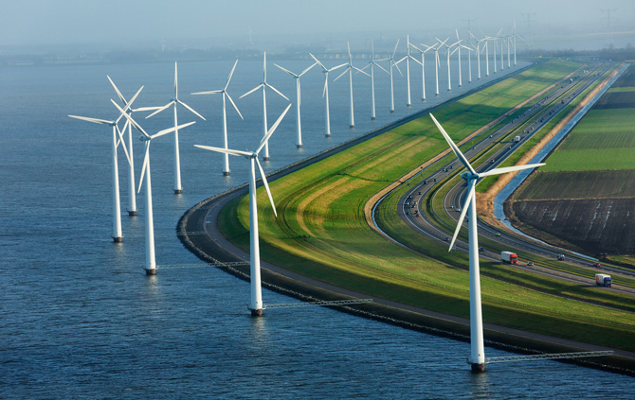
The Netherlands

Slide 41
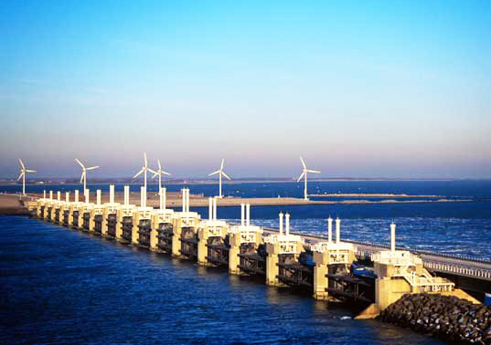
The Netherlands

Slide 42
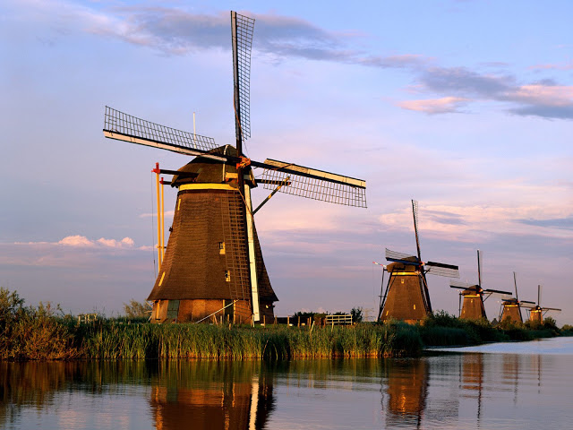
The Netherlands

Slide 43
5 Themes of Geography – Human Environment Interaction
Historically – humans change the environment for human benefit.
Concern for the now and little concern for future consequences.
Reasons for change include:
Agriculture
Economic
Development
Need for land

Slide 44
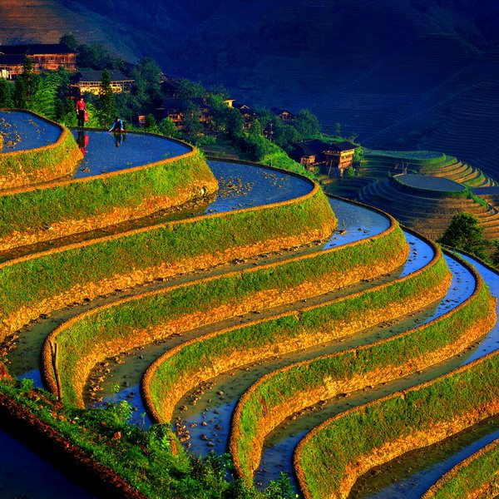

Slide 45
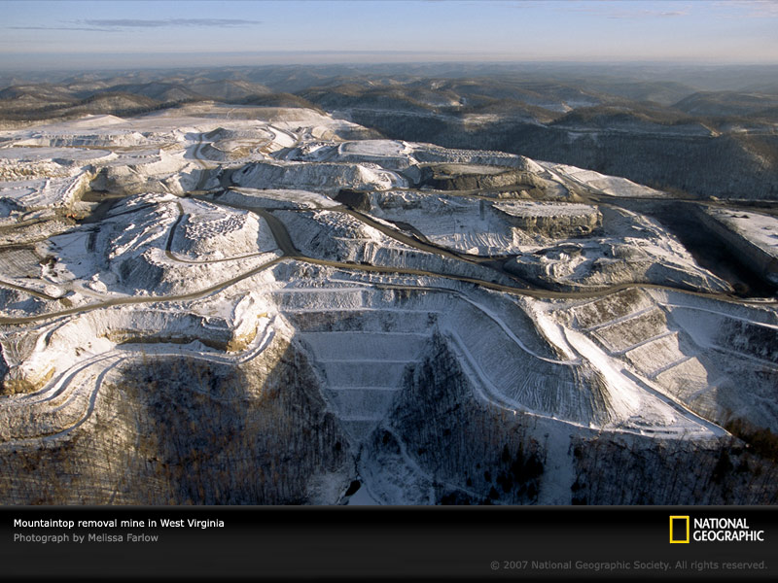

Slide 46
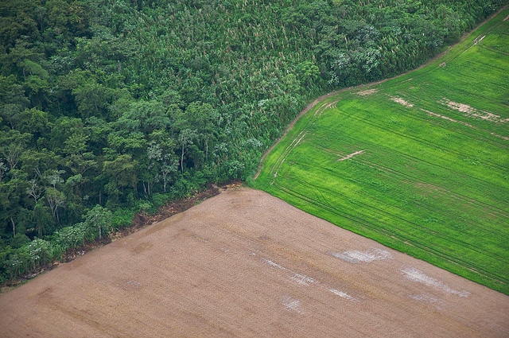

Slide 47
5 Themes of Geography – Human Environment Interaction
Fossil Fuel supply is limited
Proven Reserves – amount of energy remaining in deposits that have been discovered
1.3 trillion barrels of petroleum (50 years)
175 trillion cubic meters of natural gas (60 years)
1 quadrillion metric tons of coal (175 years)
Potential Reserves – energy in deposits that are undiscovered but thought to exist.

Slide 48
5 Themes of Geography – Human Environment Interaction
Fossil fuel supply is unevenly distributed
Coal is typically found in tropical locations.
Largest amounts of coal are found in mid-latitude regions due to continental drift theory.
China produces 40% of the world’s coal
US produces 20% of the world’s coal
Oil – 60% of proven reserves found in the Middle East
20% in Saudi Arabia
14% in Canada
Natural Gas – 25% of proven reserves in Russia

Slide 49
5 Themes of Geography – Human Environment Interaction
Consumption
North America consumes 25% of the world’s energy supplies but only has 5% of the world’s population.
Developed regions (North America & Western Europe) consume more than lesser developed regions (Asia, Eastern Europe, and Africa)
Highest consumers produce the least amount.
Highest produces consume the least amount.

Slide 50
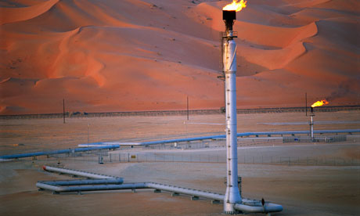
Saudi Arabian Oilfield

Slide 51
5 Themes of Geography – Human Environment Interaction
What is going to happen when lesser developed countries begin to develop???
Conflict
The majority of wars have been fought over resources
Rise in prices
As demand increases and supply decreases, prices will go up.
7 Billion: How did we get so big so fast?

Slide 52
5 Themes of Geography – Spatial Interaction or Movement
Spatial Interaction – how people and things interact with each other from across the globe.
Globalization – a force or process that involves the entire world and results in making something worldwide in scope
International borders are less important
Worldwide marketplace
Some scholars believe globalization will be the end of distinct culture regions and lead to the homogenization of world cultures.

Slide 53
5 Themes of Geography – Spatial Interaction or Movement
Globalization of Culture – uniform global landscapes of material artifacts and cultural values
Fast Food Restaurants
Automobiles
Retailers
Television
Placelessness (placeless) – having reduced diversity, significance, and a sense of place for people.

Slide 54


5 Themes of Geography – Spatial Interaction or Movement
United Kingdom
China

Slide 55
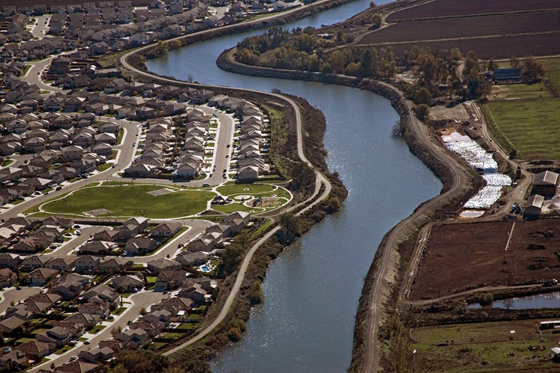
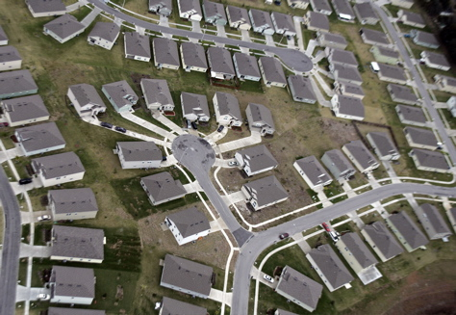
5 Themes of Geography – Spatial Interaction or Movement
California
Mississippi

Slide 56
5 Themes of Geography – Spatial Interaction or Movement
Spatial Distribution – arrangement of phenomenon across Earth’s surface
Three main parts of distribution:
Density
Concentration
Pattern

Slide 57
5 Themes of Geography – Spatial Interaction or Movement
Density – the frequency with which something occurs in space
Arithmetic Density – the total number of objects in an area
Two parts: number of item being measured and land area
Used for population
Large population does not mean high densities

Slide 58
5 Themes of Geography – Spatial Interaction or Movement
Concentration – the extent of a feature’s spread over space
Clustered – objects in an area that are close together
Dispersed – objects in an area that are far apart
What is the difference between concentration and density?

Slide 59
5 Themes of Geography – Spatial Interaction or Movement
Physiological density – the number of persons per unit of area suitable for agriculture
Agricultural density – the number of farmers per unit of area of farmland
Almost anything can be measured by density

Slide 60
5 Themes of Geography – Spatial Interaction or Movement
Concentration – the extent of a feature’s spread over space
Clustered – objects in an area that are close together
Dispersed – objects in an area that are far apart
What is the difference between concentration and density?

Slide 61
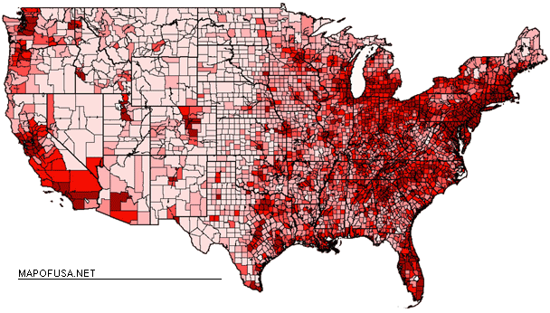
Density vs. Concentration
USA = 313.9 million people (2012)
33 people per square kilometer

Slide 62
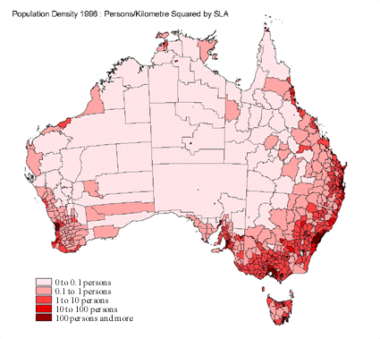
Density vs. Concentration
Australia = 23.1 million
2.9 people per square kilometer

Slide 63
5 Themes of Geography – Spatial Interaction or Movement
Pattern – the geometric arrangement of objects in space.
Geometric Patterns – i.e. subdivisions, linear
example: US Land Ordinance of 1785
Irregular patterns – anomalies

Slide 64
5 Themes of Geography – Spatial Interaction or Movement
Space-time compression – the reduction in the time it takes for something to reach another place
Promotes rapid change
As technology increases, the space-time compression becomes greater

Slide 65
5 Themes of Geography – Spatial Interaction or Movement
Spatial Interaction – interaction among groups
Networks – connections among places
The closer the groups, the greater the interactions
Distance Decay – diminishing contact with increasing distance
Why is this changing?
Spatial Association – the concept that the distribution of one phenomenon is scientifically related to the location of other phenomena

Slide 66
5 Themes of Geography – Spatial Interaction or Movement
Diffusion – the process by which a characteristic spreads across space from one place to another over time
Torsten Hagerstrand
Hearth – the place from which innovation originates (also called a node)
Different types of diffusion:
Relocation
Expansion

Slide 67
5 Themes of Geography – Spatial Interaction or Movement
Relocation Diffusion – the spread of an idea through physical movement of people from one place to another
When people move, they take cultural traits, ideas, technology, and many other things with them – good or bad
Common way for diffusion of religion

Slide 68
5 Themes of Geography – Spatial Interaction or Movement
Expansion diffusion – the spread of a feature from one place to another in a snowballing process
Three types of expansion diffusion:
Hierarchical
Contagious
Stimulus

Slide 69
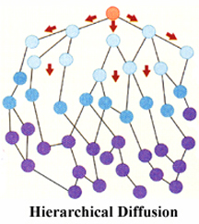
5 Themes of Geography – Spatial Interaction or Movement
Hierarchical diffusion – the spread of an idea from persons or nodes of authority or power to other persons or places

Slide 70
5 Themes of Geography – Spatial Interaction or Movement
Contagious Diffusion – the rapid, widespread diffusion of a characteristic throughout the population
The idea spreads like a wave without regard for hierarchy or relocation of people
Spread of the H1N1 Virus
New York Times Swine Flu Map
HIV/AIDS

Slide 71
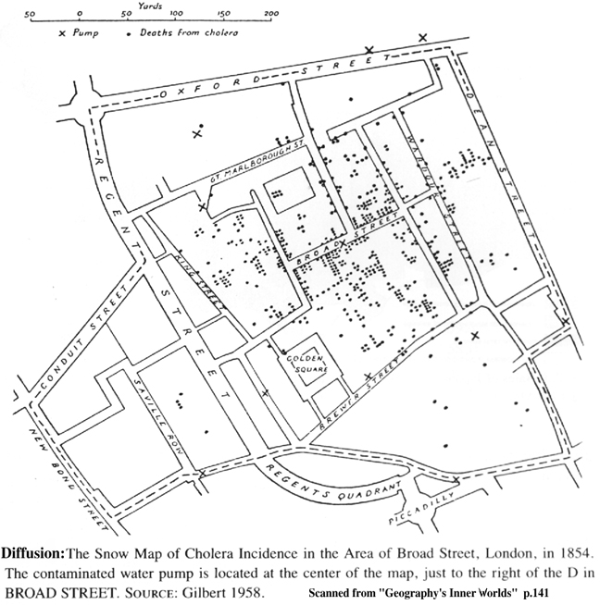
5 Themes of Geography – Spatial Interaction or Movement

Slide 72
5 Themes of Geography – Spatial Interaction or Movement
Stimulus Diffusion – the spread of an underlying principle, even though a characteristic itself apparently fails to diffuse.
Selections of ideas spread instead of the entire idea

Slide 73
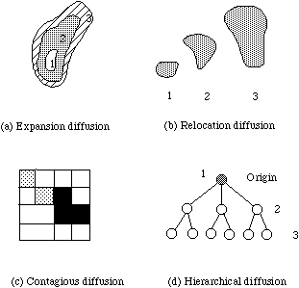
5 Themes of Geography – Spatial Interaction or Movement

Slide 74
5 Themes of Geography – Spatial Interaction or Movement
Items can spread through one mode of diffusion or a combination.
Absorbing Barriers – things that completely halt diffusion
Few exist
Permeable Barrier – allowing part of the innovation wave to diffuse through but acting to weaken or retard the continued spread

Slide 75
5 Themes of Geography – Spatial Interaction or Movement
Diffusion of Innovations
Stage 1 – innovations spread at a steady, slow rate
Stage 2 – Neighborhood Effect: acceptance is usually most rapid in small clusters around an initial adopter
Fastest rate of diffusion
Stage 3 – Diffusion slows as acceptance of the innovation is greater

Slide 76
Tools of Geographers
The map is the most important tool for a geographer.
Cartography is the science of map-making
Maps serve two purposes:
Reference
Where is something located?
What is the shortest route between two objects?
Communication
Depictions of human activities
Underlying reasoning
Data sharing

Slide 77
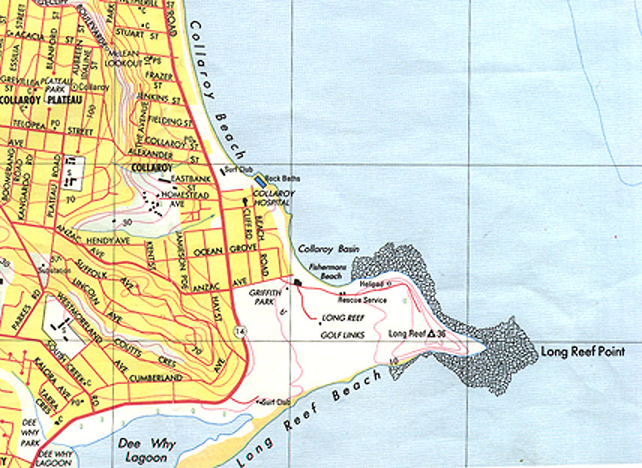
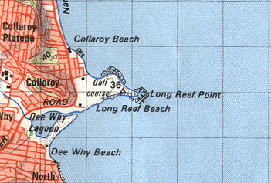
Tools of Geographers
Cartographers are concerned with two primary items – scale and projection.
Map Scale is how much of the Earth’s surface is depicted on the map.

Slide 78
Tools of Geographers
Map scale is represented three different ways
Fractional – 1/24,000
Ratio – 1:24,000
Written – 1 inch equals 24,000 miles
Fractional and ratio show the numerical ratio between distances on the map and Earth’s surface.
The number on the left side of the figure always represents the unit of distance on the map
The number on the right side of the figure always represents the unit of distance on Earth’s surface

Slide 79
Tools of Geographers
The level of detail depends on the map scale
Small scale maps show little detail (1/24,000)
Objects are relatively small
Greatest distortion and least useful
Large scale maps show greater detail (1/100)
Objects are relatively large
Least distortion and most useful

Slide 80
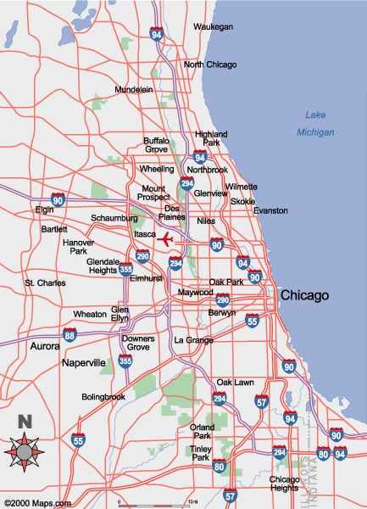
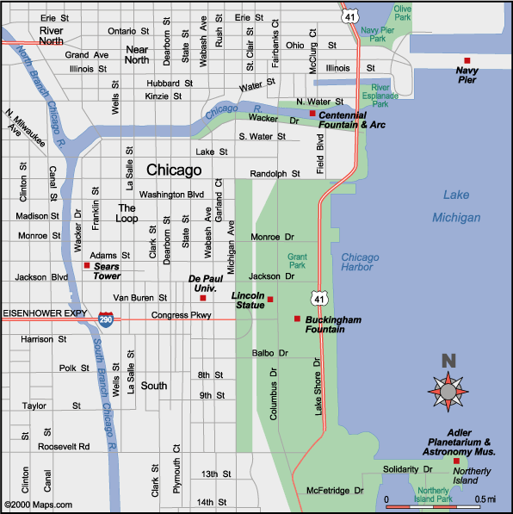
Large-scale
Small-scale

Slide 81
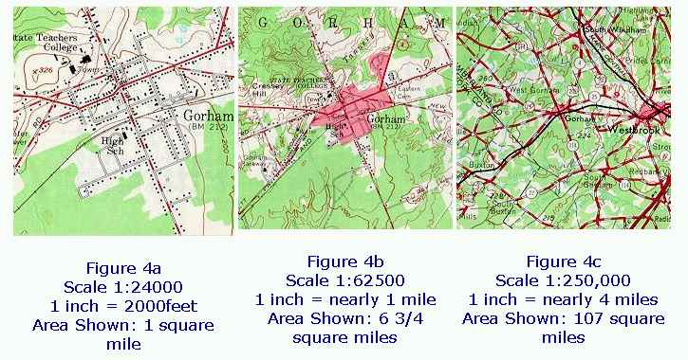
Which is the large-scale map?

Slide 82
Tools of Geographers
Projection is taking the round Earth (a globe) and creating a flat object (a map).
Extremely difficult to accomplish
Consideration is given to
Area
Shape
Distance
Only two can be represented accurately on a projection
Options:
Distortions
Omissions

Slide 83
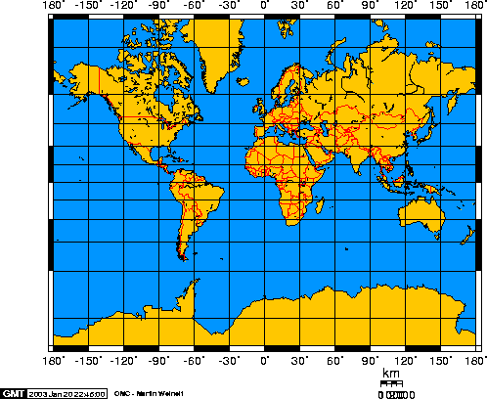
Tools of Geographers
Mercator Map Projections

Slide 84
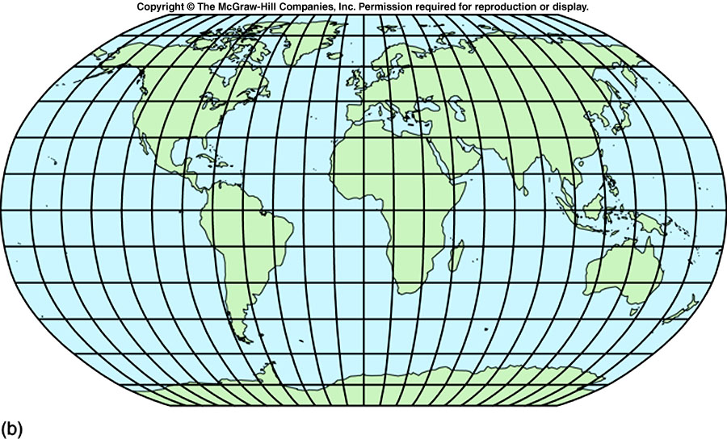
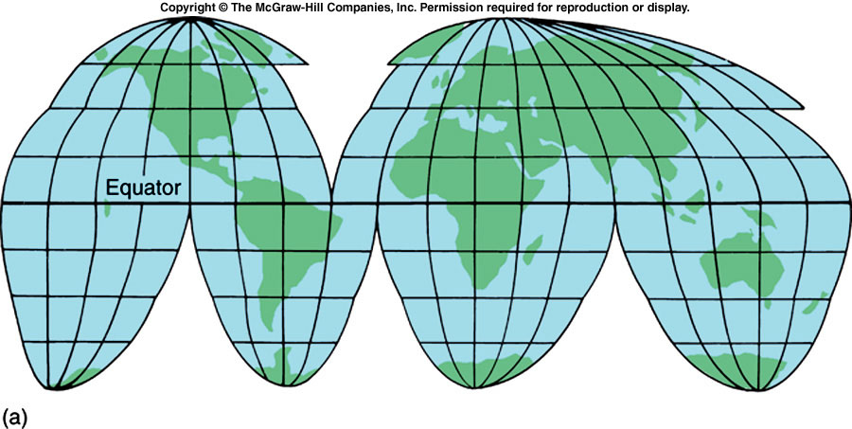
Tools of Geographers
Based on more complicated math
Interrupted, oval, combination
Robinson
Goode

Slide 85
Tools of Geographers
Physical maps shows the location and shape of the area illustrated on the map.
Mostly show natural-made objects
Topography: shape of the surface
Elevation: height above or below sea level
Contour Lines
Relief: difference in elevation
Usually shown as different colors

Slide 86
Tools of Geographers
Political maps show the boundaries and locations of political units.
Countries
States
Cities
Towns
Highways
Bridges
Most political maps show man-made objects

Slide 87
Tools of Geographers
Topographic maps (contour maps)
Also called quadrangles
Nearly 54,000 for the U.S.
Done by the US Geological Survey (USGS) since 1897
Map out the entire country in a standard fashion
Show 2D features, point, line and area; also show 3D via contour lines
Isolines (contour lines) indicate elevation
Closer isolines indicate steep slopes

Slide 88
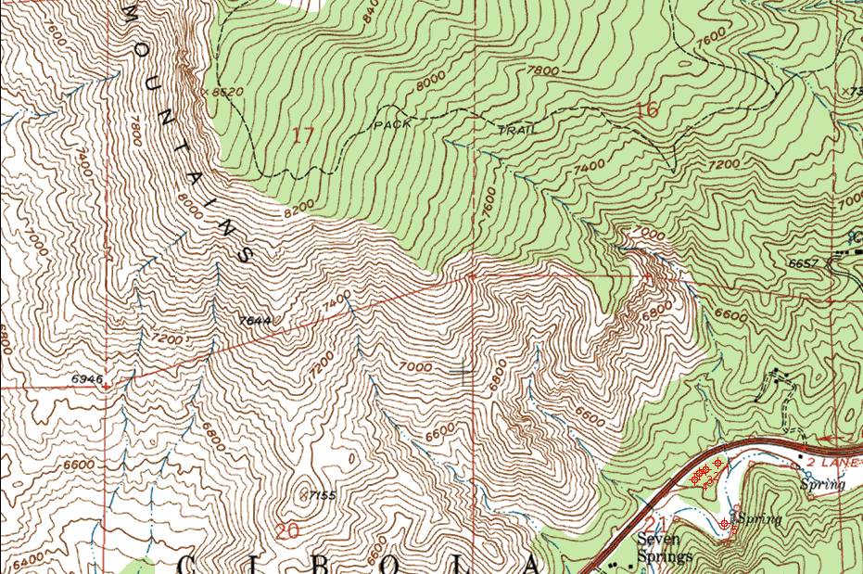
Tools of Geographers

Slide 89
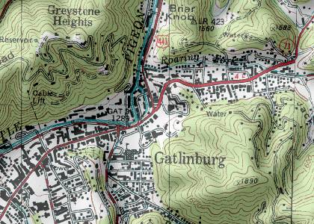
Tools of Geographers

Slide 90
Tools of Geographers
Thematic Maps depict a single feature
for example: climate, population, landform or land use.
Types of thematic maps:
Isoline – connects points of equal value
Choropleth – puts features into classes and then maps classes for each region
Proportional symbol – size of the symbol corresponds to the magnitude of the mapped feature
Dot Distribution – each dot represents some frequency

Slide 91
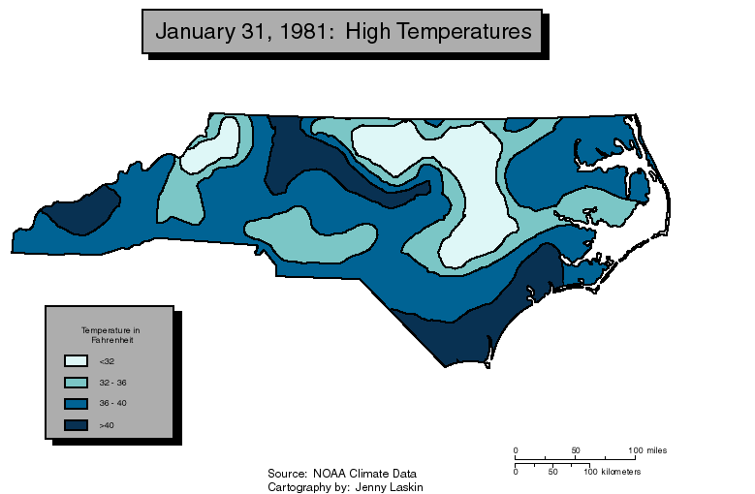
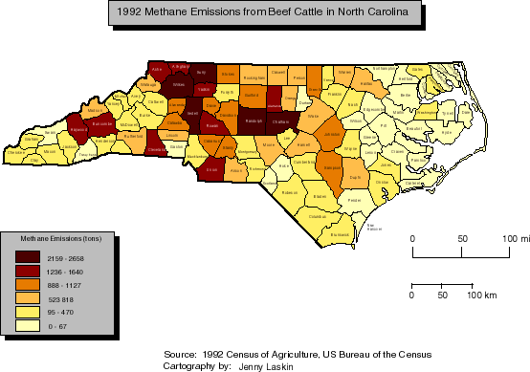
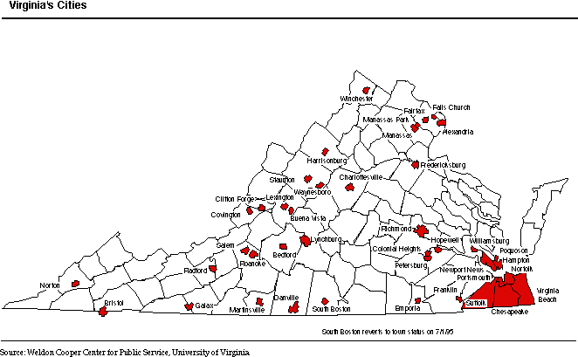
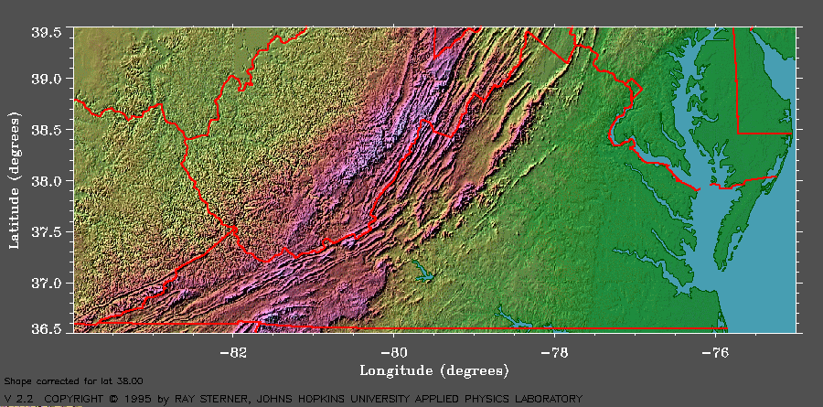
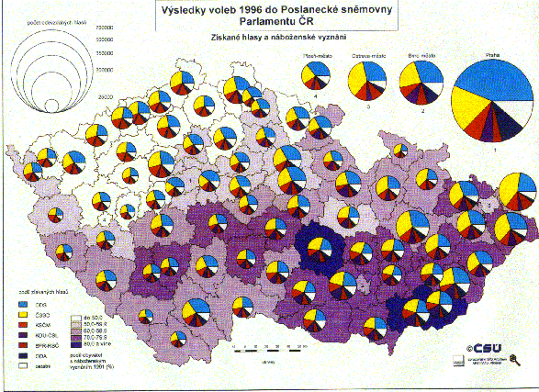
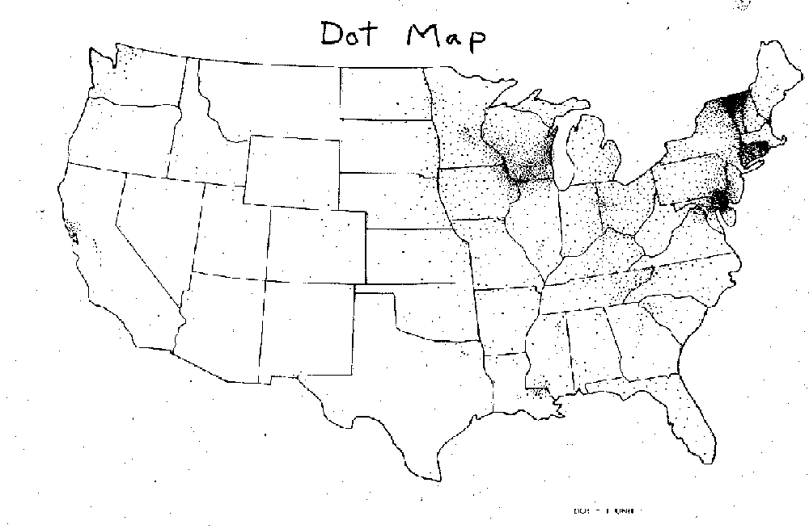
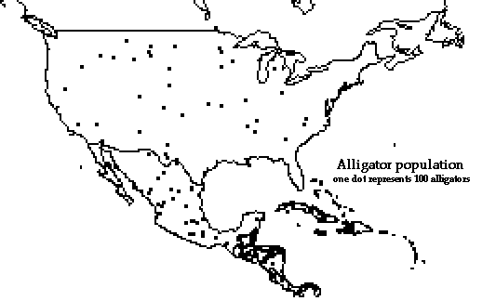
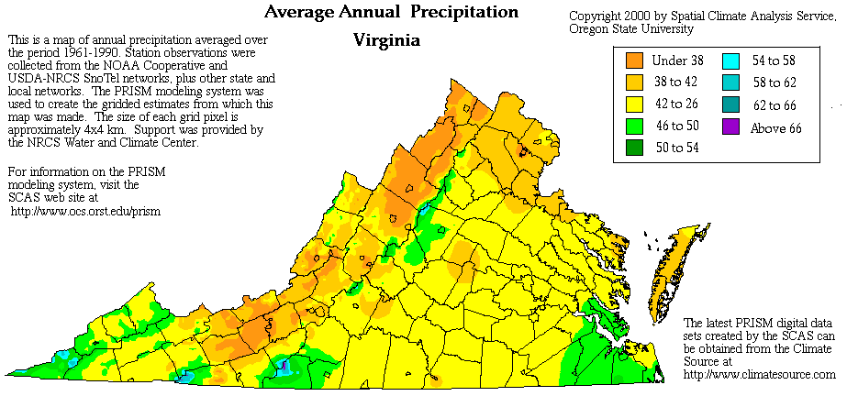
Tools of Geographers

Slide 92
Tools of Geographers
Cartograms
Maps where a thematic variable is substituted for actual land area
Used to emphasize the statistic and it’s importance
Isodemographic Map
Smaller countries can have a huge impact on the world!

Slide 93
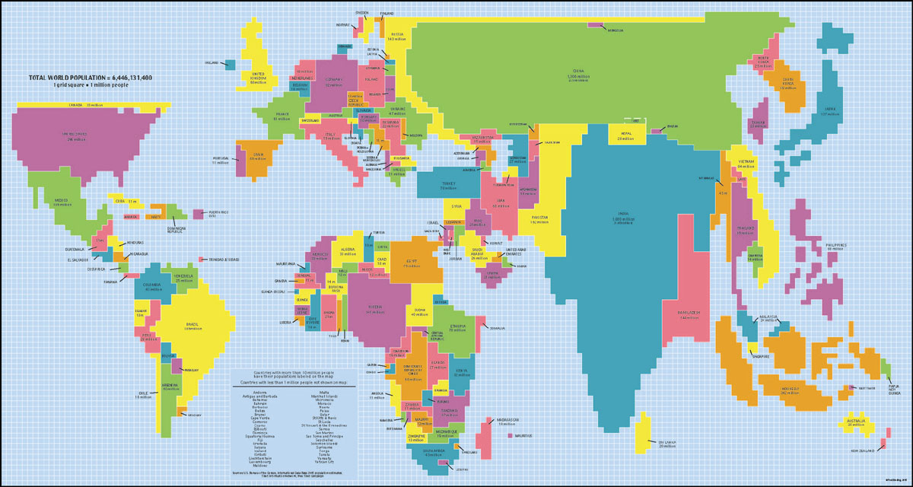
Tools of Geographers

Slide 94
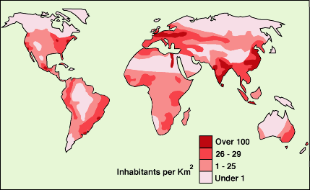
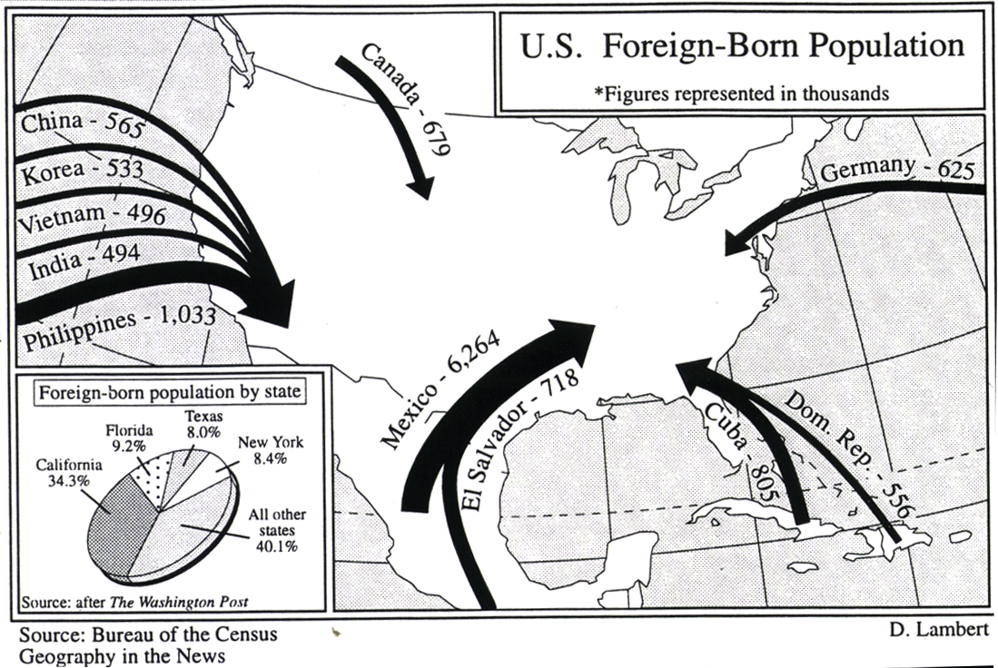
Tools of Geographers
Other types of maps
Choropleth – assigns colors or patterns to areas to show demographical data
Flow-Line – uses directional lines to indicate patters; good for determining movement

Slide 95
Tools of Geographers
Misuse of Maps
Maps, inherently, must tell “white lies”
Avoid confusion and lack of focus
Because maps are made by humans, they can be manipulated to achieve a certain purpose.
Cartographers can impose personal bias when creating a map

Slide 96
Tools of Geographers
Ways to manipulate maps
Omission
Use of color
Toponym (place name)
Size
Centers of focus

Slide 97
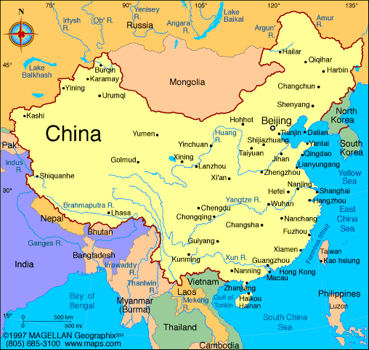

Slide 98


Slide 99

Which letter represents South?
A
D
B
C

Slide 100

Is it easier to tell now?

Slide 101
Tools of Geographers
Technology is constantly changing how Geography is studied.
Prior to computers and technology, cartographers were limited in scope and distortion of maps they could produce
Global Positioning Systems (GPS)
Allows the determination of the exact location on Earth
Geographic Information Systems (GIS)
Allows the creation of maps using multiple layers of information
Remote Sensing
Allows the use of satellite and aerial photography to study land use changes over time

Slide 102
Tools of Geographers
Geographic Information Systems (GIS)
A computer system that can capture, store, query, analyze, and display geographic data.
Used to produce maps
Each type of information is stored in a layer. Maps can have multiple layers of information.
Layers are used to show relationships between different kinds of information.

Slide 103

Tools of Geographers

Slide 104

Tools of Geographers

Slide 105
Tools of Geographers
Remote Sensing
Data about the Earth from satellites or other long-distance methods
Types of remote sensing
Pictures
Radar
Sonar
Other advanced technology

Slide 106

Tools of Geographers

Slide 107

History of Geography
The Modern Period
Cultural Ecology: the study of human-environment relationships
Koppen Climate Classification System
Divides the Earth’s surface into 5 regions based upon annual and monthly temperatures and precipitation

Slide 108
History of Geography
Environmental Determinism
Cultures are a direct result of where they exist
Physical environment causes social development with climate being the most critical factor
Humans are clay to be molded by nature:
Carl Ritter
Friedrich Ratzel
Ellen Churchill Semple
Ellsworth Huntington

Slide 109
History of Geography
“The well-known contrast between the energetic people of the most progressive parts of the temperate zone and the inert inhabitants of the tropics and even of intermediate regions, such as Persia, is largely due to climate… the people of the temperate zones rank so far above those of the other parts of the world that they are natural leaders.”
Ellsworth Huntington and C.W. Cushing
Principles of Human Geography, 1940

Slide 110
History of Geography
Environmental Determinism
Examples:
Peoples of the mountains were predestined by the rugged terrain to be simple, backward, conservative, unimaginative and freedom-loving
Dwellers in the desert were likely to believe in one god but live under the rule of tyrants
Temperate climates produced inventiveness, industriousness, and democracy
Coastlands produced great navigators and fisherman

Slide 111
History of Geography
Environmental Determinism
Provided an excuse for colonialism
“Because the natives of tropical climates (Latin America and Africa) were naturally lazy and slow, they would benefit from the presence of the naturally stronger, smarter, and more industrious peoples who came from more temperate lands (Europe).”
Dismissed as being prejudicial and incorrect.
Determinists made the mistake of overemphasizing the role of environment. This does not mean environment does not have an effect; it is one of many reasons.

Slide 112
History of Geography
Possiblism
The physical environment may limit some human activities, but people have the ability to adjust to their environment.
People make choices based upon factors offered by the environment.
Environment helps shape culture, however it is ultimately dependent upon the choices people make among the possibilities.

